Slide 1
Springboard Capstone 2 WESAD dataset Meditation and Social Stress
Walter Piper

Slide 2
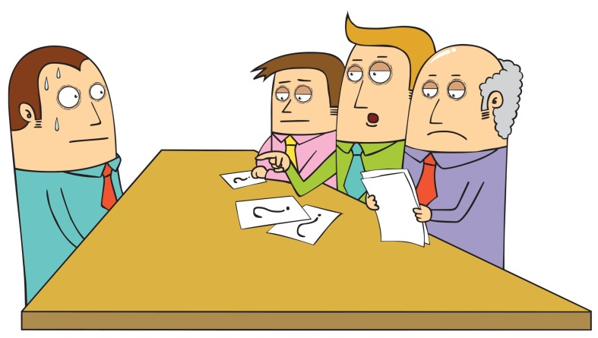
Problem identification: Resilience to social stress during performative endeavors
Problem Identification | Data Wrangling | Exploratory Data Analysis | Preprocessing | Modeling | Documentation
Social stress is inevitable and potentially unhealthy.
Sympathetic nervous system is responsive to social stress.
Elevated heart rate and sweating.
Excessive “fight-or-flight” responses can lead to exhaustion and a loss of psychological safety.
Can consumer wearables play a role in measuring resilience and finding effective coping strategies?
Does meditation increase resilience?

Slide 3
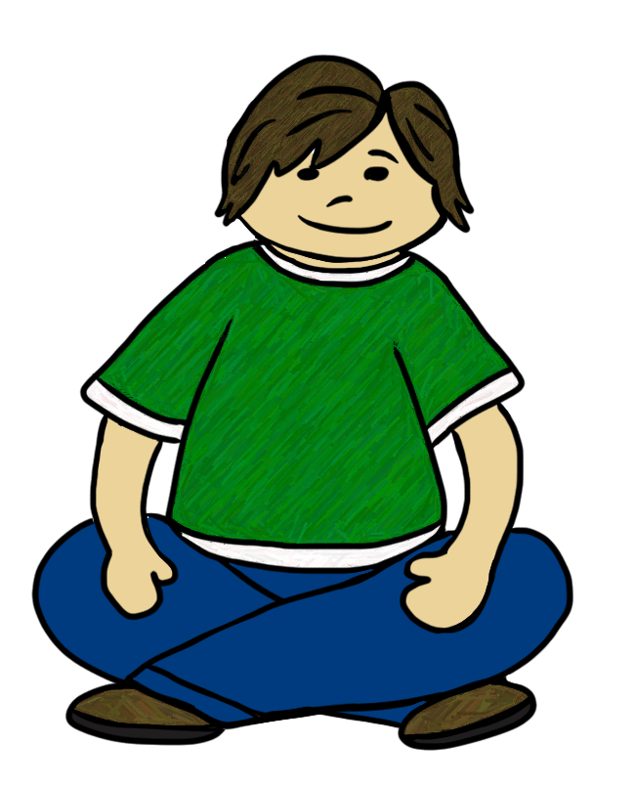
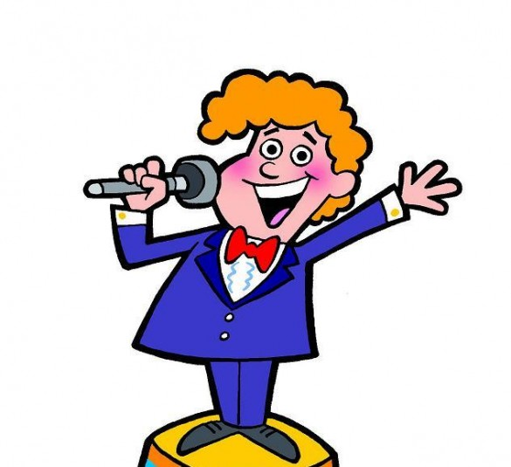

Wearable Stress and Affect Detection (WESAD) dataset (repository link)
Problem Identification | Data Wrangling | Exploratory Data Analysis | Preprocessing | Modeling | Documentation
15 human subjects
Baseline, Trier social stress test, amusement, 2 meditation sessions.
Two experimental conditions (1st meditation/amusement before vs. after social stress):

Slide 4
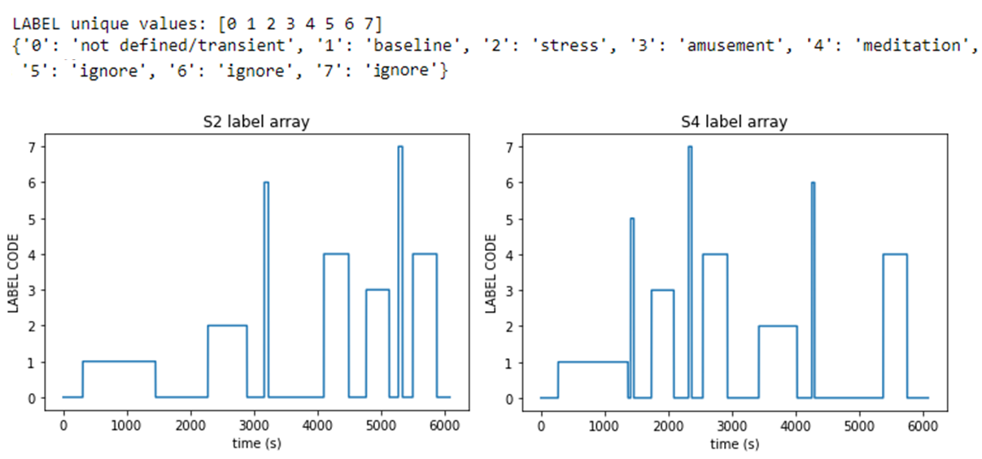
Wearable Stress and Affect Detection (WESAD) dataset
Problem Identification | Data Wrangling (notebook on Github) | Exploratory Data Analysis | Preprocessing | Modeling | Documentation
15 human subjects
Baseline, Trier social stress test, amusement, 2 meditation sessions.
Two experimental conditions (1st meditation/amusement before vs. after social stress):
Social stress first
Meditation first
Amusement & meditation
Amusement & meditation
Social stress
Social stress

Slide 5
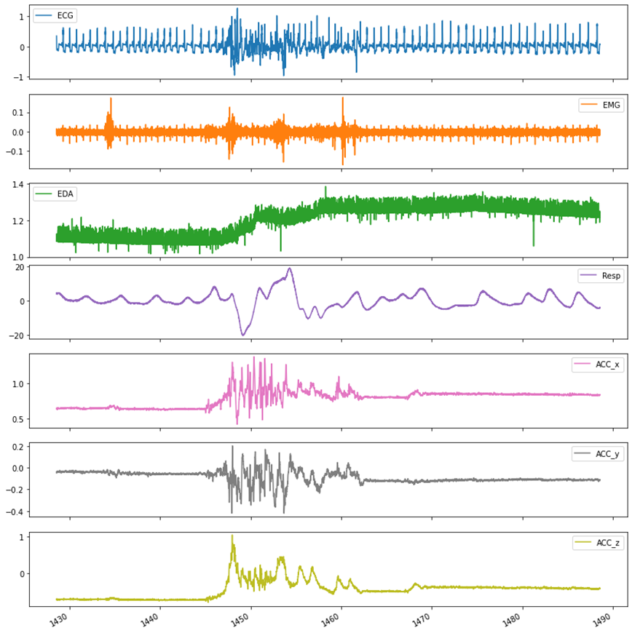
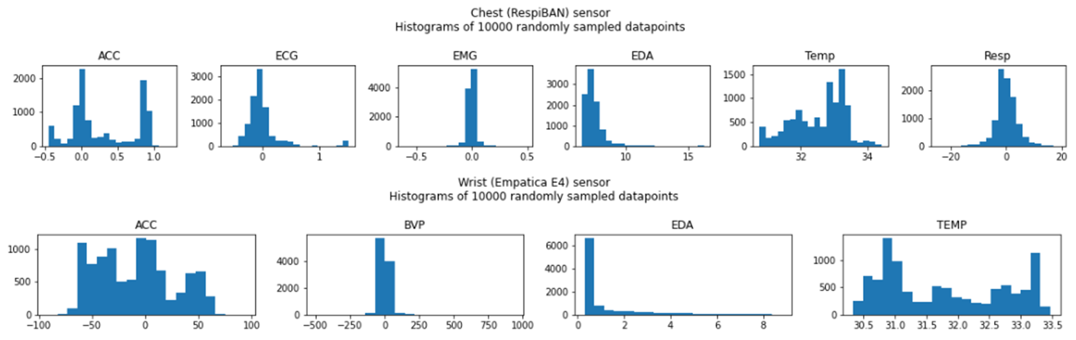
WESAD dataset
Problem Identification | Data Wrangling (notebook on Github) | Exploratory Data Analysis | Preprocessing | Modeling | Documentation
Wearables record physio metrics:
Electrocardiography, Electrodermal activity, Electromyography, Respiration, Accelerometers on chest and wrist.
Self-report affective questionnaires
Personal details (age, weight, smoker status…)

Slide 6
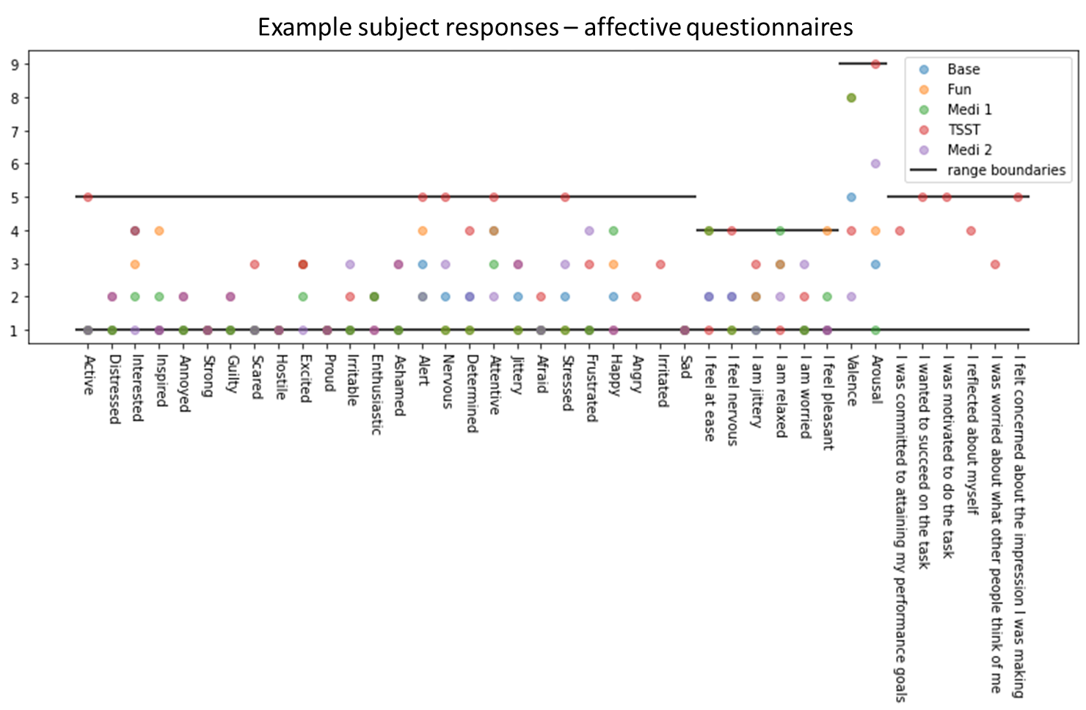
WESAD dataset
Problem Identification | Data Wrangling (notebook on Github) | Exploratory Data Analysis | Preprocessing | Modeling | Documentation
Wearables record physio metrics:
Electrocardiography, Electrodermal activity, Electromyography, Respiration, Accelerometers on chest and wrist.
Self-report affective questionnaires
Personal details (age, weight, smoker status…)
Categorical data later encoded by one-hot encoding

Slide 7
WESAD dataset
Problem Identification | Data Wrangling (notebook on Github) | Exploratory Data Analysis | Preprocessing | Modeling | Documentation
Did you drink coffee today?
NO 11
YES 4
Did you drink coffee within the last hour?
NO 15
Did you do any sports today?
NO 13
YES 2
Are you a smoker?
NO 14
YES 1
Did you smoke within the last hour?
NO 15
Do you feel ill today?
NO 14
YES 1
 | Age | Height (cm) | Weight (kg)
mean | 27.5 | 177.6 | 73.1
std | 2.45 | 6.75 | 10.27
Wearables record physio metrics:
Electrocardiography, Electrodermal activity, Electromyography, Respiration, Accelerometers on chest and wrist.
Self-report affective questionnaires
Personal details (age, weight, smoker status…)
Categorical data later encoded by one-hot encoding
Gender
male 12
female 3
Dominant hand
right 14
left 1

Slide 8
Signal Processing to Extract Meaningful Physiological Features
Problem Identification | Data Wrangling | Exploratory Data Analysis | Preprocessing | Modeling | Documentation
Custom transformations to convert raw data streams to meaningful features.
Example: Heart rate information extracted from ECG data.
Physio features then aggregated over experimental task segment.
Example: Average heart rate during social stress task.

Slide 9
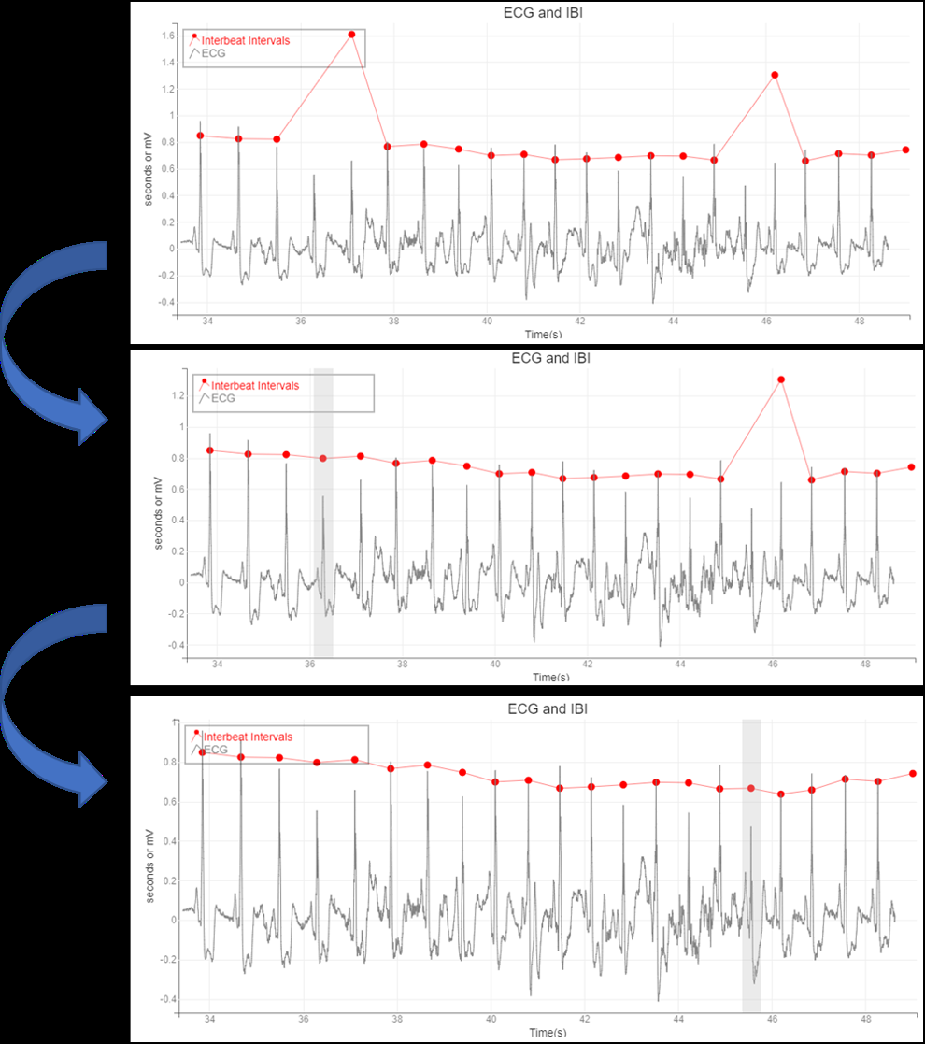
Transformations: Electrocardiogram (ECG)
(ECG Notebook on Github)
Biosppy package
Hamilton segmentation algorithm for ECG
Followed by custom GUI to clean errors
ipywidgets
bqplot

Slide 10
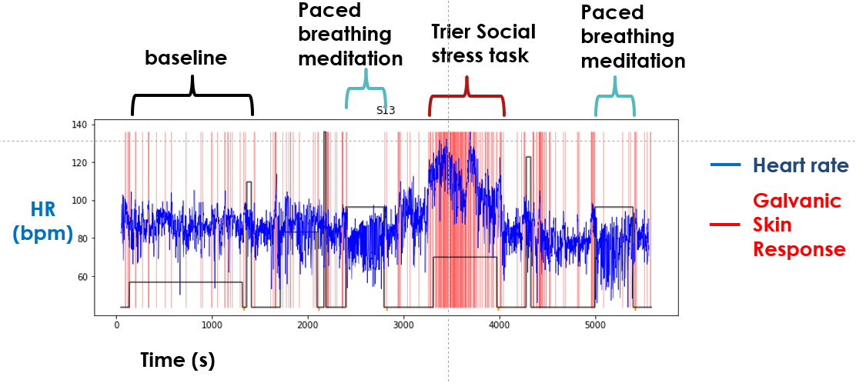
Transformations: Electrodermal activity
(Electrodermal Notebook on Github)
Downsample to 4 Hz and compute change in skin conductance at each time point
Scipy’s peak finding finds sudden increases in skin conductance
Indicates sweating

Slide 11
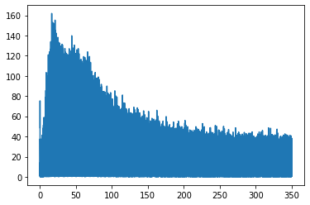
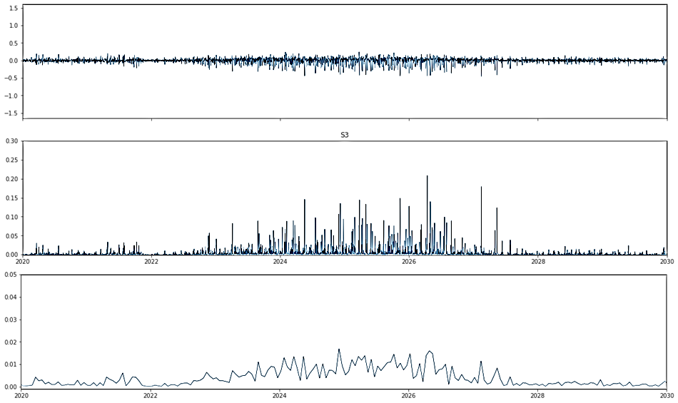
Transformations: Electromyography (EMG)
(EMG, accelerometers, respiration Notebook on Github)
Fourier Transform of EMG
High-pass FIR filter applied (32Hz)
Power
Raw EMG data is high-pass filtered (32Hz)
Then squared to obtain power
Then downsampled to 20Hz to smooth
Frequency (Hz)
Raw EMG
Filtered & squared
Downsampled

Slide 12
Transformations: Accelerometers (chest and wrist)
(EMG, accelerometers, respiration Notebook on Github)
Raw data differenced
Then squared
Then downsampled
10 Hz for chest accelerometer
8 Hz for wrist accelerometer

Slide 13
Respiration
(EMG, accelerometers, respiration Notebook on Github)
Transformation:
Downsampled to 10 Hz
Aggregation for respiration consistency/coherence:
Total energy of autocorrelation function (up to 7000 lags)

Slide 14
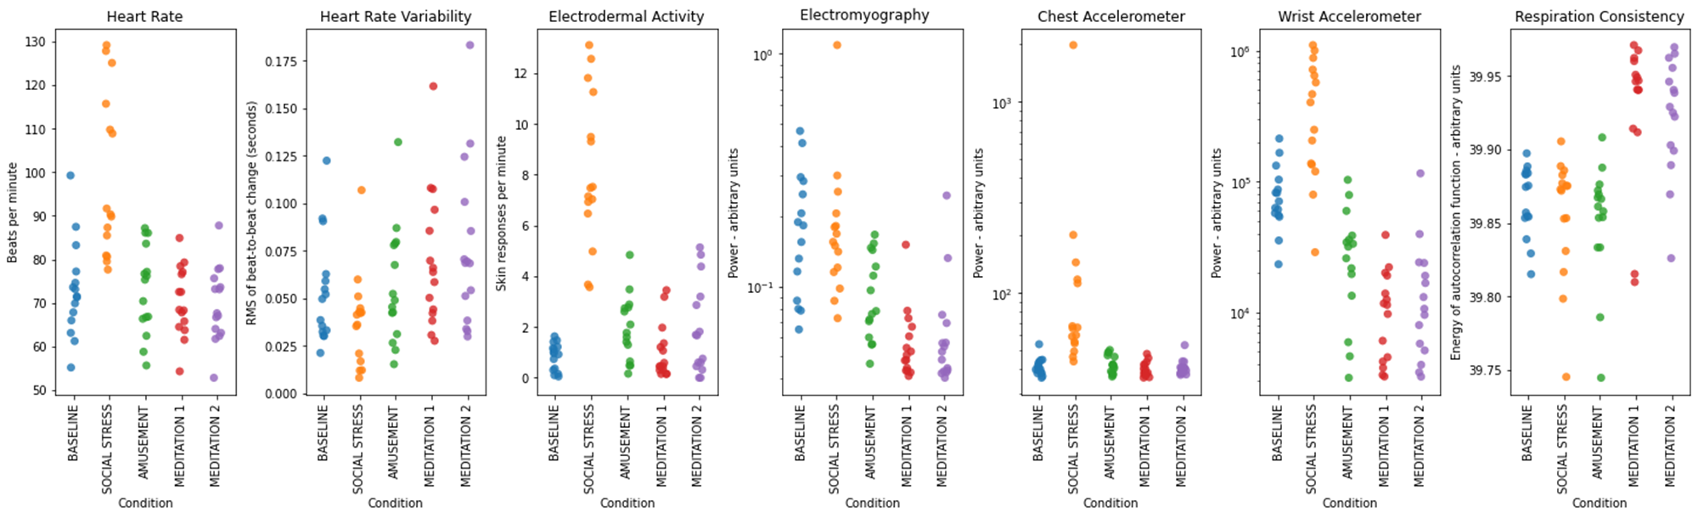
Exploratory Data Analysis
Problem Identification | Data Wrangling | Exploratory Data Analysis (Github) | Preprocessing | Modeling | Documentation
Different tasks display expected physiological profiles
Social stress – high heart rate, high electrodermal activity
Consistent with sympathetic nervous system activation

Slide 15
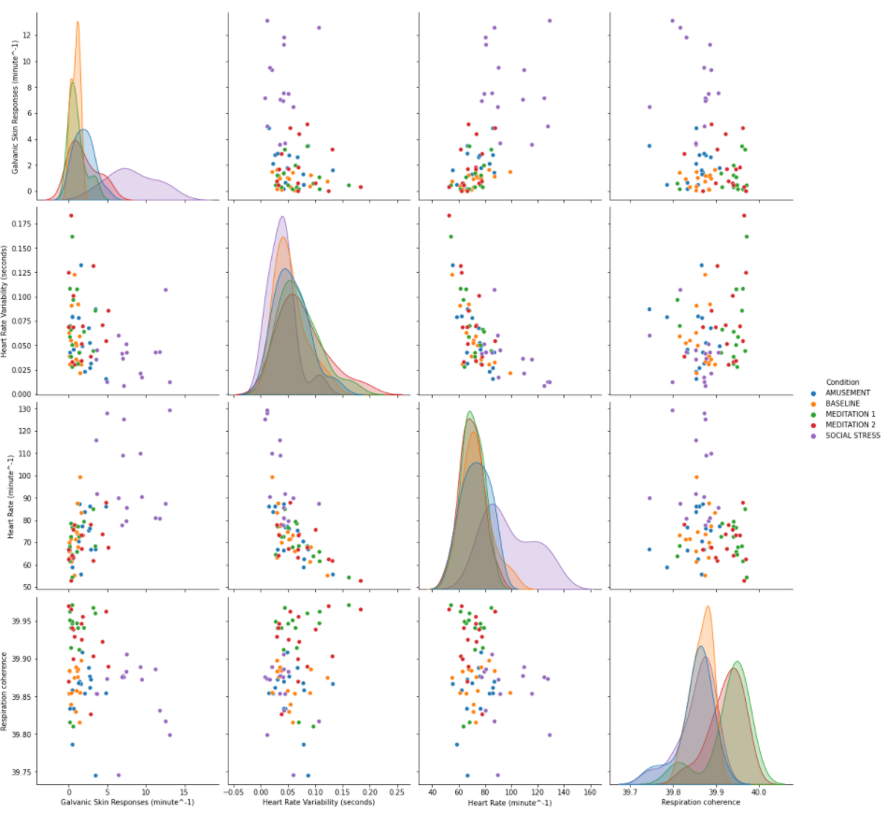
Exploratory Data Analysis
Problem Identification | Data Wrangling | Exploratory Data Analysis (Github) | Preprocessing | Modeling | Documentation
Galvanic skin responses
Heart rate correlated with electrodermal activity (Galvanic skin responses)
Heart rate inversely correlated with heart rate variability
May be an artifact of how HRV was calculated
Is consistent with opposing influences of sympathetic (HR) and parasympathetic (HRV) nervous systems.
Heart rate variability
Heart rate
Respiration coherence
Heart rate variability
Galvanic skin responses
Heart rate
Respiration coherence

Slide 16
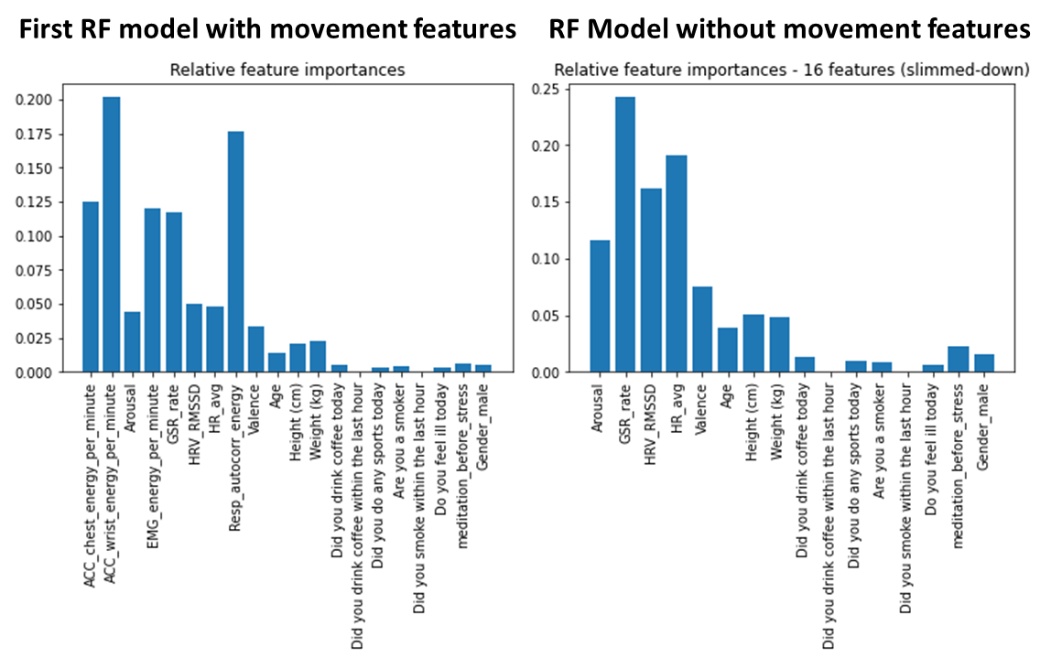
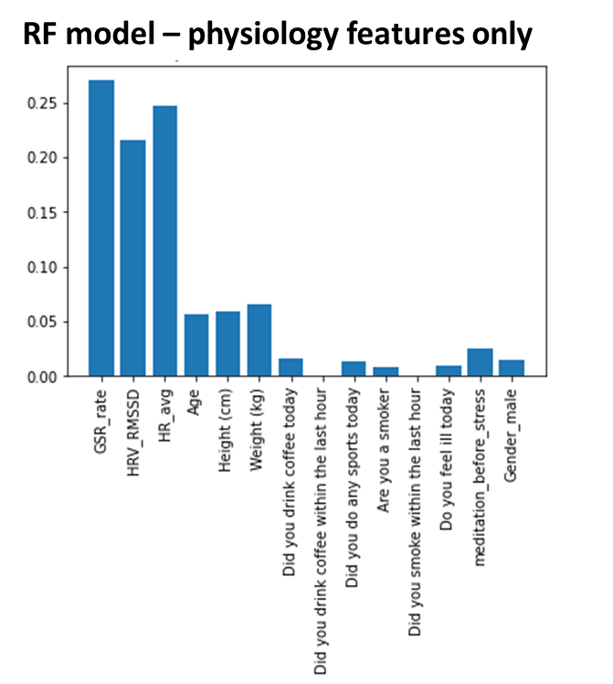
Feature Selection and Random Forest Model for Task Prediction
Problem Identification | Data Wrangling | Exploratory Data Analysis | Preprocessing (notebook on Github) | Modeling | Documentation
Class | Random Forest Accuracy All Features | RF Accuracy without EMG, accelerometers, & respiration | RF without EMG, accelerometers, respiration, and without valence/arousal
Social stress | 100% | 88% | 75%
Amusement | 40% | 10% | 0%
Meditation | 96% | 74% | 61%
Baseline | 91% | 18% | 18%

Slide 17
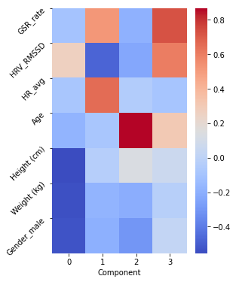
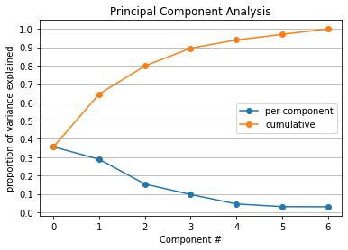
Modeling the Social Stress task Predicting amusement/meditation before stress
Problem Identification | Data Wrangling | Exploratory Data Analysis | Preprocessing (Github) | Modeling | Documentation
Indicative of autonomic nervous system activity
Step 0 – Standard scaler (Z-score)
Step 1 – Principal Component Analysis

Slide 18
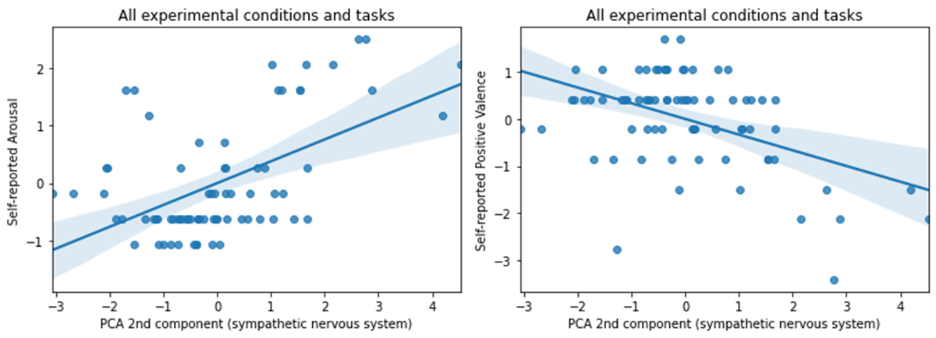
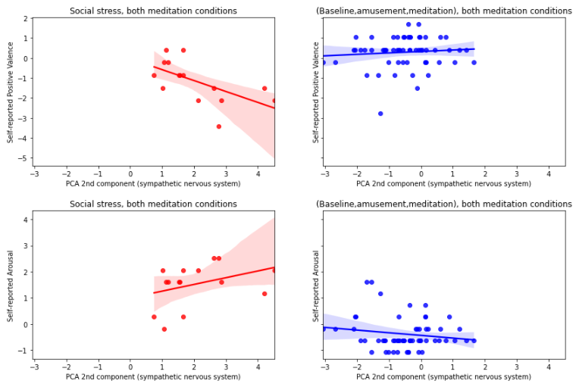
Psychological correlates of sympathetic nervous system
Problem Identification | Data Wrangling | Exploratory Data Analysis | Preprocessing | Modeling (Github) | Documentation
Social stress
All other task segments

Slide 19
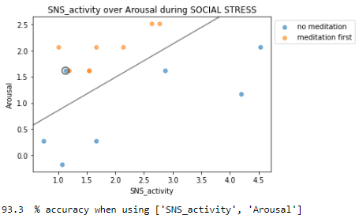
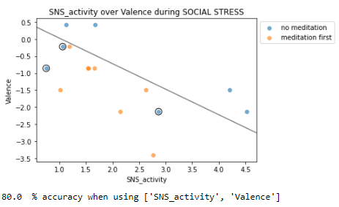
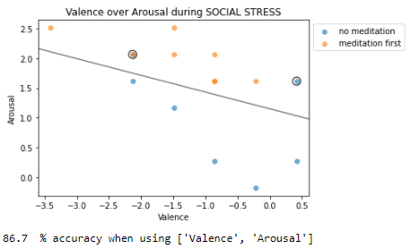
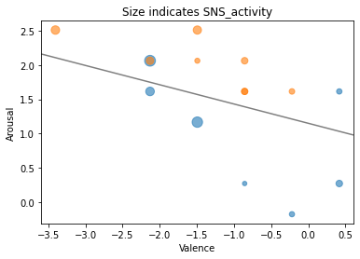
Modeling (Predicting recent meditation condition)
Problem Identification | Data Wrangling | Exploratory Data Analysis | Preprocessing | Modeling (Github) | Documentation
2-dimensional visualizations
With arousal over SNS model:
Support vectors are significantly different:
p=0.002

Slide 20
Final Modeling
Problem Identification | Data Wrangling | Exploratory Data Analysis | Preprocessing | Modeling (Github) | Documentation
Arousal, Valence, and SNS activity (2nd PCA component) were used as features.
Experimental condition (meditation before stress versus no meditation) was target.
Due to small sample (n=15), a variation of cross-validation was used to obtain accuracies:
Repeated 1000 times: 12 training points, 3 test points (sampled without replacement)
Class | Support Vector Classifier (C=1) | Logistic Regression (C=10)
Meditators | 99.3% | 100%
Non-meditators | 64.7% | 65.9%
Total | 83.1% | 84.3%

Slide 21
Recommendations
Problem Identification | Data Wrangling | Exploratory Data Analysis | Preprocessing | Modeling | Documentation
If findings hold up to further research:
Meditation and/or amusement can be used to buffer against social stress.
Wearable consumer tech can be used to help optimize the way we prepare for social stress.

Slide 22
Future directions
Problem Identification | Data Wrangling | Exploratory Data Analysis | Preprocessing | Modeling | Documentation
These findings should be replicated with larger sample size.
Models did well in identifying meditators, but less well with non-meditators. Perhaps there are observable patterns in some non-meditators that indicate they are already ready for social stress. If so, wearable devices could identify and guide people who are not ready for social stress.
Future work could try using smaller segments with the aim of real-time implementation of similar models.

